Slide 1
Manuscript Markup with TEI
Buddhist Manuscripts as Digital Text
M.Bingenheimer, 2009
“Manuscripts don’t burn”
M.Bulgakov, The Master and Margarita 1940

Slide 2
scholarly markup project
Scholarly Acumen:
- research questions
- quality of the data
- publications, posters
- grant proposal writing
Technical Acumen:
- technical standards
- interface design
- longterm usability
- cross platform design
Project Management:
- Budget control
- Personnel
- Scheduling
- Training
- Communication with
stake holders

Slide 3
Manuscript digitization - Stages
Transcription
Textual Markup
Schema design
Linking to Digital Images
Metadata Design
Interface Design

Slide 4
1.Transcription
Is a digital version of the |text| already available?
NO → create a digital text.
YES → Is it less work to change the existing version than to re-type the text from the manuscript?
  Closeness of versions
  Error rate
  What constitutes difference? (Gaiji, etc.)
  What to do with previous markup?

Slide 5
2. Textual Markup
What phenomena do I want to mark?
Often relevant for manuscripts
  Textstructure <div> <p> <lg> <l>
  Page-, linebreaks <pb> <lb>
  Substitutions, deletions, additions <subst> <del> <add>
  Corrections <choice> <corr> <sic>

Slide 6
2. Textual Markup
Relevant for manuscripts
  Gaps or illegible parts <gap>
  Damage <damage>
  Text supplied by the encoder into the transcription <supplied>
  Text partly illegible <unclear>
  Scribal comments <note>
  Images in the text <figure>

Slide 7
2. Textual Markup
Critical apparatus: <app>, <lem>, <rdg wit=>...
Content markup?:
  Person & place names (needs authorities) <persName>, <placeName>, <roleName>, <name>...
  Dates <date>
  Citations <cit>
  Pointers and links <ptr>

Slide 8
2. Textual Markup - Punctuation
Add punctuation
Enclose in <c> (algorithmically) (Chinese full-space punctuation marks help with the automatic replace)
→ Switch the punctuation on and of as needed.

Slide 9
3. Schema Design
Get a TEI schema from ROMA or VESTA
Add these modules:
  transcr
  msdescription
  gaiji
  textcrit
  verse
  figures

Slide 10
3. Schema Design
Keep the ODD file, otherwise you won’t be able to develop the schema.
Keep on validating while you work
Trim your schema until it contains (almost) only necessary elements, it will be easier to manage that way
Restrict attribute values

Slide 11
4. Linking to digital facsimiles
摹本1
<facsimile> between <teiHeader> and <text>
Simplest solution: Step 1 (between header and text)
<facsimile> <graphic>....</facsimile>
<facsimile>
<graphic url="BD6776a.jpg"/>
<graphic url="BD6776b.jpg"/>
</facsimile>

Slide 12
4. Linking to digital facsimiles
摹本2
Step 2:
Link text passages to facsimile IDs via @facs (@facs (facsimile) points to all or part of an image which corresponds with the content of the element.)
<div facs="BD6776a.jpg">...</div> or
<pb facs="BD6776a.jpg"/> or...

Slide 13
5. Metadata design
see presentation on msDesc
you might need more than TEI:
MIX: Metadata for still Images in XML
METS: Metadata Encoding and Transmission Standard

Slide 14
6. Presentation interface design
...ad libitum, but
General rules for interface design:
  Accessibility (no red/green differences etc.)
  Low server footprint
  Easy to maintain (PHP vs. Java, CSS vs. JS)
  Documented
  Simplicity

Slide 15
6. Presentation interface design
Basic question: relationship between digital facsimiles and digital text in the interface
Solution A: The interface mainly shows the text → cut the image
Solution B: The interface mainly shows the facsimile? → cut the text
Solution C: Equal rights. Both text and images are present. → integrate both

Slide 16
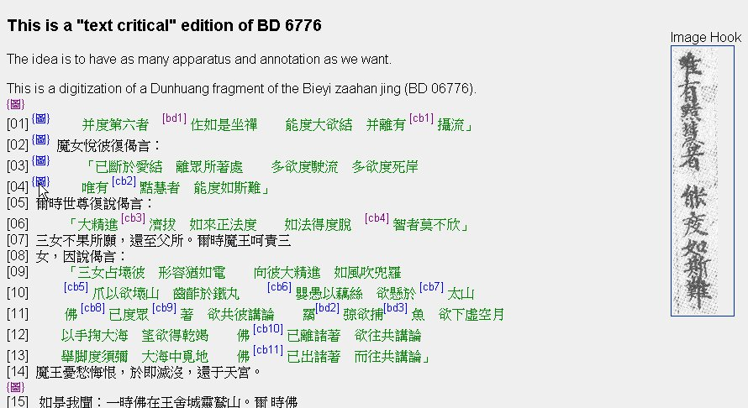
A: Cut the image
Link images/image eras to the text (TEI: @facs)

Slide 17
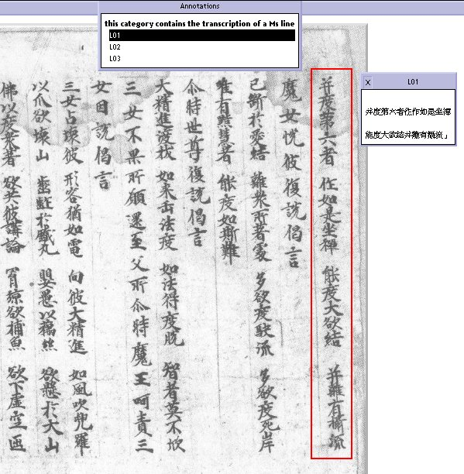
B: Cut the text
Using the Image Markup Tool by M. Holmes you still keep the text in TEI
This links the image to the text

Slide 18
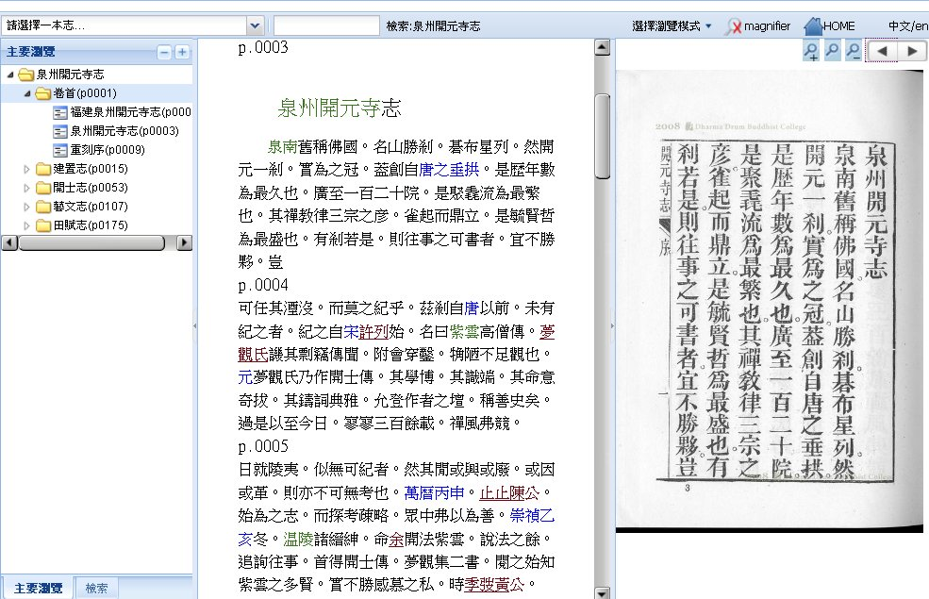
C: “Equal rights” (here in a EXT JS library)

Slide 19
Evaluation
In general, I tend to C “equal rights” solutions: align larger passages of digital text and facsimiles
+: no need for cutting, minimize “interesting- phenomenon-at-the-border-problem”, simple
-: programming a JS library means slightly more IT overhead
There are scenarios where A or B is preferable instead.

